Slide 1
Building a generation of
political leaders
in Global Health
Notes:
“Building a generation of political leaders on Global Health”

Slide 2
quem somos
A rede cresceu e tornou-se um grupo colaborativo de decisores políticos e parceiros unidos pela vontade de melhorar os sistemas de saúde e o bem-estar dos seus cidadãos a nível global.
rede global sem fins lucrativos e apartidária
500 membros em 112 países
fundada em 2017 pelo Dr. Ricardo Baptista Leite, MD
apoiar parlamentares em todo o mundo na promoção e adoção de políticas baseadas em evidência, fortemente ancoradas ciência e nos dados
Notes:
1/ Who we are
UNITE is a non-profit, non-partisan, global network of current and former members of parliament from multinational, national, state, and regional Parliaments, Congresses, and Senates, committed towards the promotion of efficient and sustainable policies for improved global health systems, in alignment with the United Nations Sustainable Development Goals.
UNITE’s policy priorities focus on three cross-cutting areas, namely, human rights and equitable access to health, health systems strengthening, and global health architecture and security, placing UNITE as the only network of parliamentarians from around the world currently focusing on the global health agenda.
UNITE was founded in February 2017 by Ricardo Batista Leite, MP, MD, and under the auspices of UNAIDS. Since then, the network has grown to become a worldwide collaborative group of policymakers and partners united by the desire to improve global health systems worldwide and their citizens wellbeing, convinced that no life should be limited by infectious diseases or any other global health threat.

Slide 3
priority areas of work
o que fazemos
direitos humanos e acesso equitative à saúde.
A UNITE centra a sua atividade em fornecer aos seus membros apoio técnico e parlamentar.
conectar parlamentares com
proporcionar ferramentas de advocacy adequadas
fortalecimento dos sistemas de saúde
comunidades afetadas
organizações internacionais
no momento certo
no formato adequado
academia
sociedade
civil
agir em conformidade nos parlamentos
governos
arquitetura e segurança de saúde global
Notes:
2/ What we do
UNITE focuses its activity in providing technical and parliamentary engagement support to its members by connecting them together, connecting them with affected communities, civil society, academia, and governments, and by providing them with the right advocacy tools at the right moment, to act accordingly in their Parliaments.
UNITE’s work is guided by the objectives of the United Nations Sustainable Development Goals (SDG) and despite focusing its efforts on SDG 3 to reach good health and wellbeing for all, UNITE’s members strongly believe it will take a multisectoral approach contemplating the entirety of the UN SDGs to promote efficient and sustainable policies for improved global health systems worldwide.
UNITE held a Global Board Meeting in Rabat to discuss the UNITE Strategy for the upcoming years. In this event the UNITE Strategic Plan for 4 year was adopted and has been shaping the priorities of the organization in terms of content and events, around the 3 following pillars:
Human rights and equitable access to health;
Strengthening of health systems;
Global health architecture and security.

Slide 4
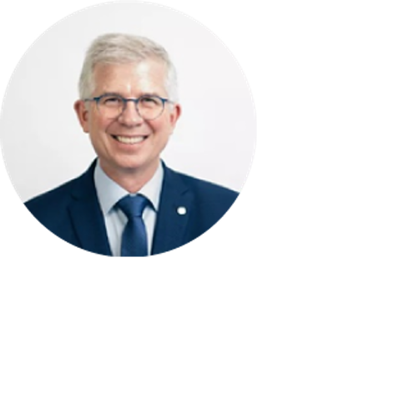
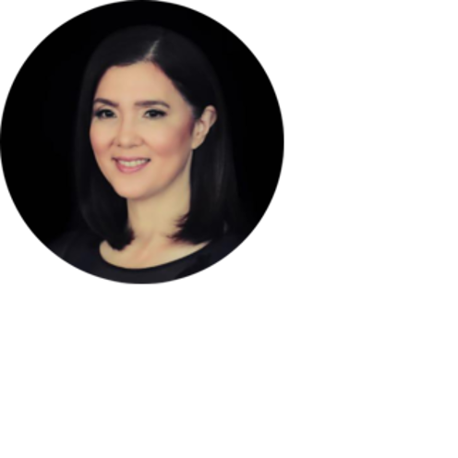
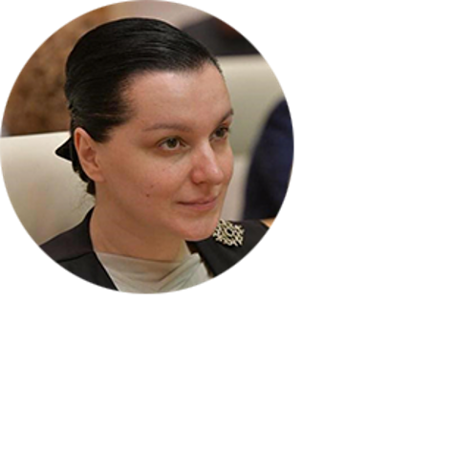
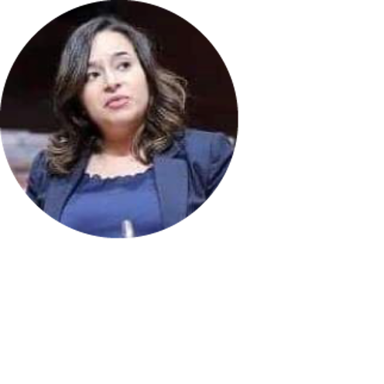
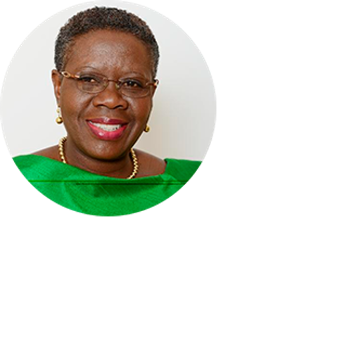
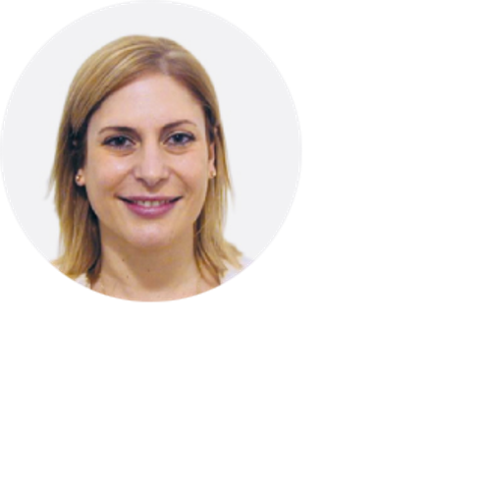
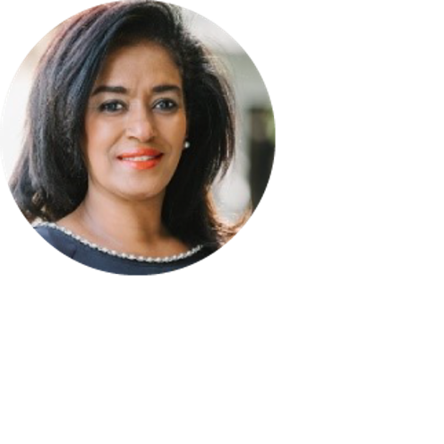
quem somos
Europa Central e Ocidental
Dep. Andrew .Ullmann.
Europa de Leste e Ásia Central
Ásia Pacífico
Sen. Pia Cayetano.
10 regiões.
EUA & Estados Unidos
Dep. Mariam Jashi.
Dep. Sonia .Sidhu.
Dep. Ricardo .Baptista Leite.
China.
Médio Oriente e Norte de África
Índia .
direção não executiva
Dep. Ibtissame .Azzaoui.
Dep. Amar .Patnaik.
África Ocidental e Central
América Latina e Caraíbas.
.Hon. Akua Dansua.
secretariado
Dep. Gisela Scaglia.
Africa Oriental e Austral.
Hon. Esther Passaris.
Notes:
3/ Where we do it
UNITE is divided into 10 Chapters, namely Northern and Central America, South America and the Caribbean, Western and Central Africa, Eastern and Southern Africa, Middle East and Northern Africa, Western Europe, Eastern Europe and Central Asia, Asia Pacific, India, and China. This division aims at tailoring UNITE’s action to each region of intervention, adapting the network’s support to the reality and cultural specificities of each Chapter.
UNITE is governed by a non-executive board which is currently composed of eight Chapter Chairs, Honourable Gisela Scaglia (Argentina), Honourable Akua Dansua (Ghana), Honourable Esther Passaris (Kenya), Honourable Ibtissame Azzaoui (Morocco), Honourable Andrew Ullmann (Germany), Honourable Mariam Jashi (Georgia), Honourable Pia Cayetano (Philippines), Honourable Amar Patnaik (India), and led by its President and founder, Ricardo Baptista Leite (Portugal). The global board is supported by a secretariat based in Lisbon.

Slide 5
how we
do it
atividades e campanhas
plataformas
Formações
Mesas redondas
Policy briefs
Forum Internacional de Saúde Global
Policy desks
Sub-comités de Saúde Global
Campanhas de advocacy e comunicação
Cimeira Global
Notes:
4/How we do it
UNITE develops its work at national regional and global level threw a variety of platforms:
Creation of International Forum on Global Health
Support of Global Health subcommittees around the world at regional and national level (ex. Germany, Malaysia, Sierra Leone, Kenya, EU informal working group on HIV)
Policy desks (drug policy, digital health)
And promotes activities and materials such as:
Capacity building sessions for Parliamentarians;
Parliamentary roundtables gathering CSOs, academia, affected communities, global partners; building bridges between main stakeholders at national and regional level;
Policy briefs and recommendations to the network of parliamentarians;
Promotion of advocacy and communications campaigns alongside partners
Promotion of an annual gathering of policy makers on global health (Summit)

Slide 6
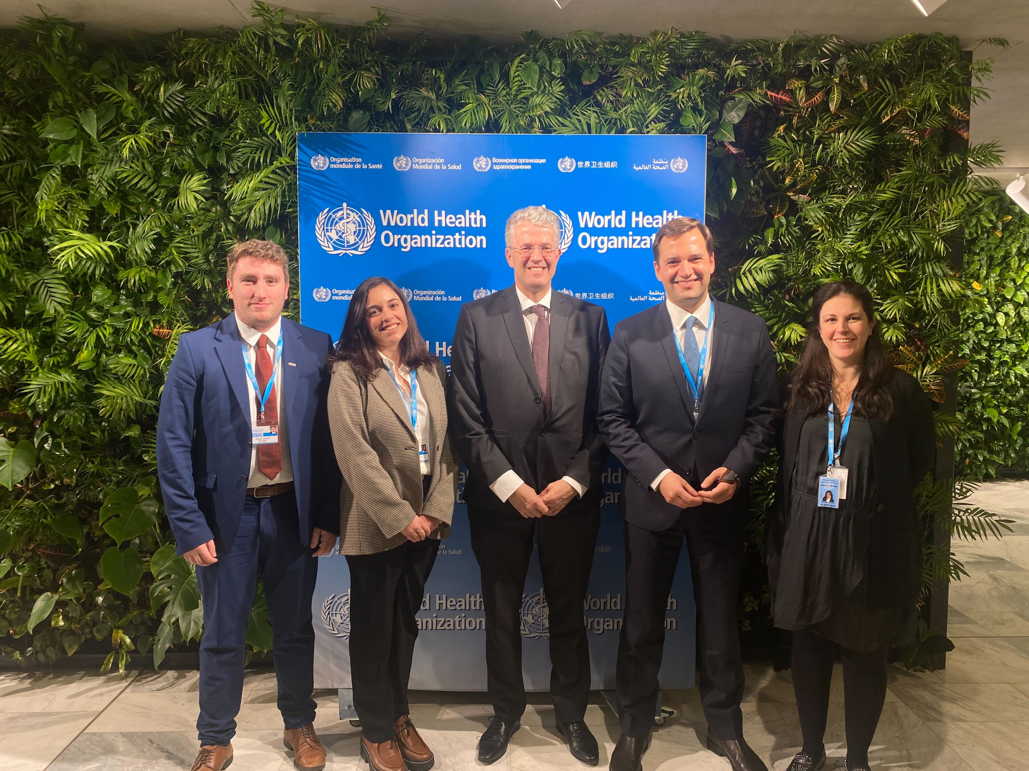
Memorandum
OMS
- 5 anos de Memorandum de Entendimento
- Reuniões regulares com unidades técnicas
- Plano de trabalho centrado no financiamento da OMS nos dois primeiros anos
Notes:
6/ What is next?
UNITE’s 2022-2025 strategic plan was drafted during the last months and will be officially adopted at UNITE’s global board meeting in Rabat on June 5th and 6th .
UNITE’s strategic plan wants to answer the following question: How can UNITE International Parliamentary Network for Global Health support policymakers in promoting efficient and sustainable policies for improved global health systems worldwide?
1. A stronger and more integrated network
To accelerate change and support parliamentarians work to promote efficient and sustainable policies for improved global health systems, UNITE needs to grow its membership and representation around the world in order to present increased opportunities of networking and experience sharing between members, partners, affected communities and civil society representatives.
Metrics and objectives for 2025
UNITE aims to secure representation in 120 countries around the world.
UNITE aims at recruiting a representative from at least two different political parties in each country where it is present.
UNITE aims at growing its membership at least by 100 parliamentarians each year and reach the number of 600 members by the end of 2025.
UNITE aims at recruiting board members for all its Chapters, raising the number to 11 board members sitting in the non-executive board.
2. A connecting platform for policymakers in global health
Beyond growing the network in terms of quantity and quality, it is also important to develop the connections between the network itself and between the network and other partners who are willing to support UNITE’s action and in a position to bring an added value to parliamentarians’ work. This stream of work will focus on the development of the International Forum on Global Health and the increased support of Global Health subcommittees around the world.
Metrics and objectives for 2025
UNITE aims at increasing representation of Parliamentary networks in the International Forum on Global Health (IFGH) up to 20 active networks.
UNITE aims at increasing the regional representation of Parliamentary networks in the IFGH to cover all regions of the globe (Americas, Africa, Asia Pacific, Europe).
UNITE aims at establishing a sustainable and functional work plan for the IFGH with at least four capacity building sessions and one in-person field visit a year.
UNITE aims at establishing and/or supporting at least 20 Global Health Subcommittees in national or regional Parliaments.
UNITE will establish and/ or support Global Health Subcommittees in at least 80% of its Chapters to ensure an equal geographical representation and influence.
3. A global health policy lab for parliamentarians
Growing the network and its connectivity goes with growing its added value. Why does a member join UNITE? What can UNITE bring to their work? To answer those questions, UNITE has chosen to develop and increase its production of information and guidance to parliamentarians. More than creating scientific evidence, UNITE will serve as a policy lab where science meets public policy and proposes a series of action plans for parliamentarians who wish to take the agenda forward in their countries.
Metrics and objectives for 2025
UNITE aims at establishing a sustainable fellowship program with a community of 25 committed fellows.
UNITE aims at holding regular global health policy workshops for parliamentarians.
UNITE aims at positioning the Global Summit as one of the Global Health calendar’s milestones, and the only platform to connect with more than 100 policymakers on global health topics.
UNITE aims at developing solid partnerships with universities and sign at least 10 Memorandum of Understanding with International Schools and Universities.
UNITE aims at developing and leading 5 international classes on Global Health Parliamentary Diplomacy worldwide.
4. A window of opportunity for impact
Combining a stronger and more connected network to a dynamic platform of information gives the right tools for UNITE’s members to act, whenever a window of opportunity opens. With that in mind, the last, but not less essential pillar of this strategy focuses on identifying the windows of opportunity for change and communicating them in a timely manner to the right audience. UNITE will act as a conductor for change orchestrating the flow of information and directing it to the people who can implement it the right way.
Metrics and objectives for 2025
UNITE aims at developing five dedicated Policy Desks to lead its work in specific global health areas of intervention.
UNITE aims at launching a mobile application for members in order to communicate with them in a timely and efficient manner.
UNITE aims at developing policy calculators within the Unite application to guide parliamentarians work with scientific evidence-based information turned into policy suggestions

Slide 7
impacto
AO NÍVEL GLOBAL
Conectar 100+ parceiros a deputados
Contribuições como relevant stakeholder no processo de negociação do Acordo Pandémico
Participação em fóruns globais (Assembleia Mundial Saúde, Reuniões de Alto Nível)
10+ declarações em reuniões de alto nível 2023
AO NÍVEL NACIONAL
Membros da UNITE como co-autores de 5 propostas de lei na área de Política de Drogas e Doenças Infecciosas
Desenvolvimento de planos de ação política em Saúde Digital em 3 países
Apoio na criação do Subcomité de Saúde Global em Portugal

Slide 8
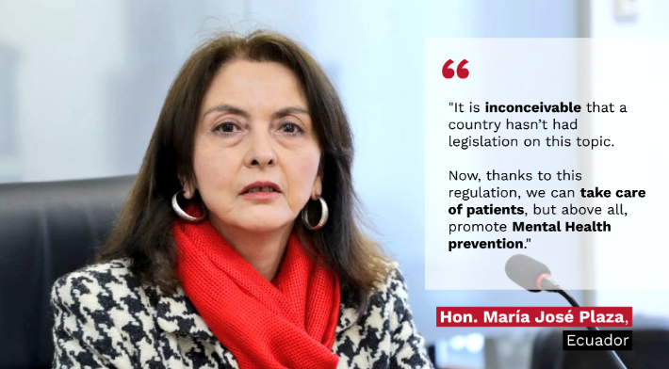
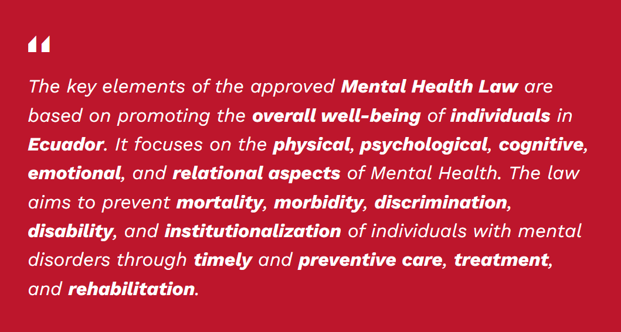
impacto
Saúde mental na América Latina
Pela primeira vez, o Equador tem uma Lei de Saúde Mental. A deputada María José Plaza, membro da UNITE, foi uma das figuras-chave por detrás da recente aprovação desta lei.

Slide 9
www.unitenetwork.org
It’s time to
unitenetwork@unitenetwork.org
@UNITE_MPNetwork
@unite_mpnetwork
UNITE Global Parliamentarians Network for Global Health
@UNITE.Parliamentarians.Network.for.Global.Health
Notes:
“Building a generation of political leaders on Global Health”

